Slide 1
The art of innovation
How to Create Conditions for Innovation to Happen
Luiz de Mello, Deputy Director
Public Governance and Territorial Development Directorate
OECD

Slide 2
Public Sector vs. Private Sector Innovation

Slide 3
Barriers to Innovation
Public servants are not good at identifying and managing risks.
Innovators do not get recognized nor rewarded.
Internal regulations can come at a high cost in terms of innovation.
Traditional problem-solving structures are not adapted to the complexity of today’s issues.
Lack of flexibility in allocating and managing financial resources.

Slide 4
Overcoming Barriers: OECD work on public sector innovation

Slide 5
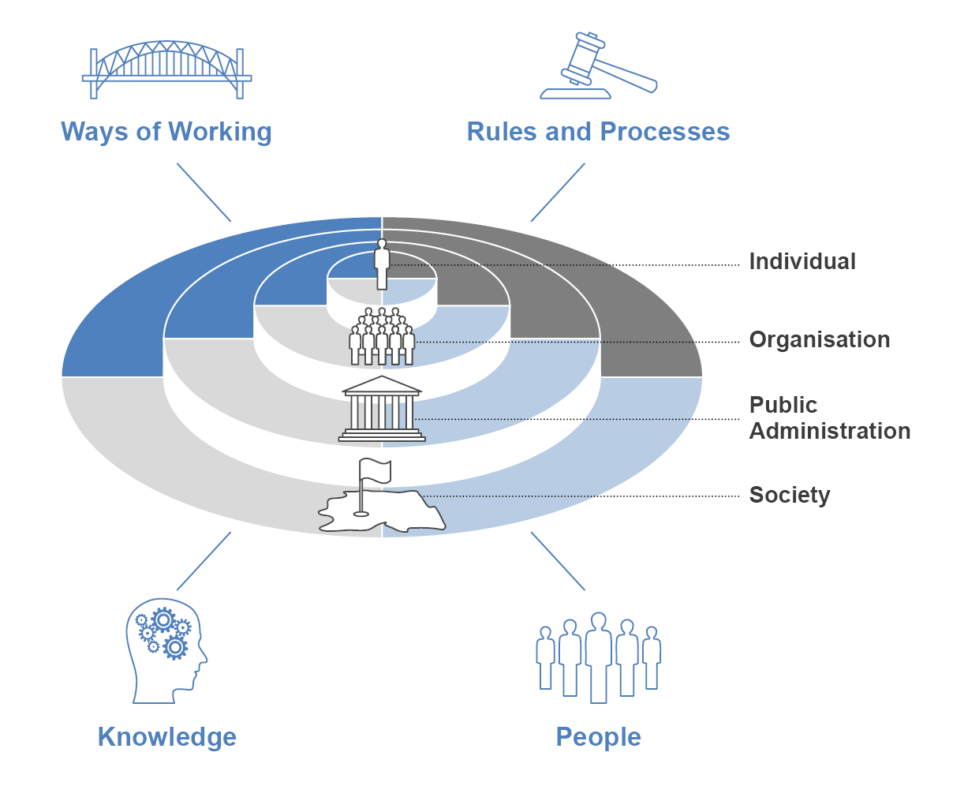

Slide 6
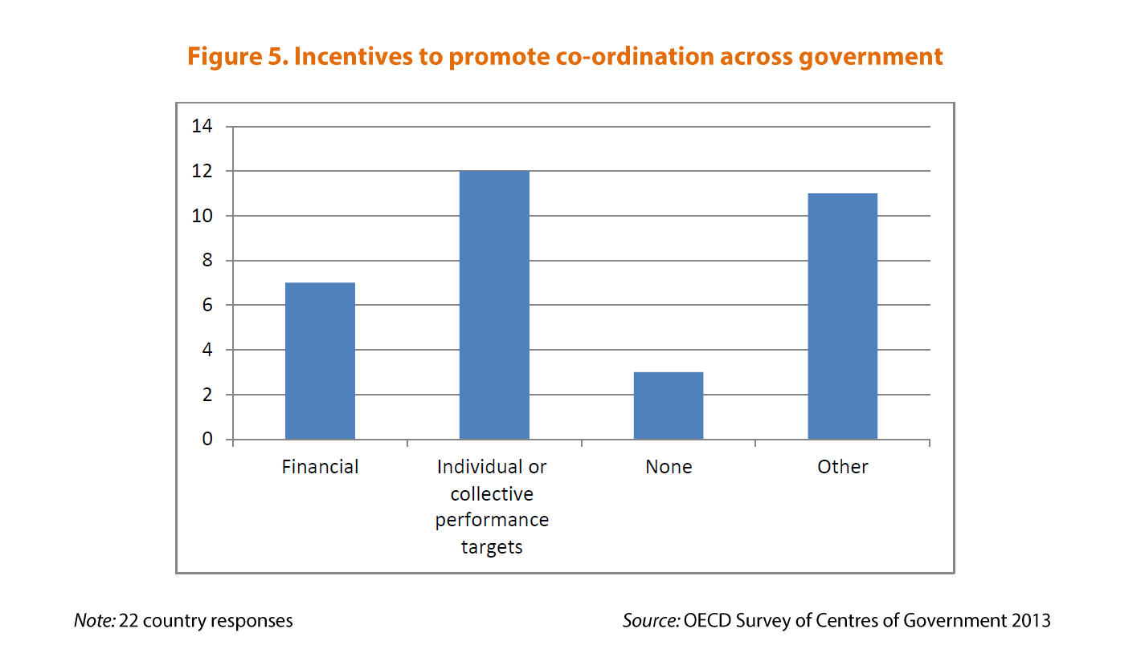
People: strengthening human skills and capacities
Incentivize staff and build a culture of innovation
Encourage innovations to come from staff at all levels
Support individual employees as they innovate within an organisational culture
Reward successful innovations, while also supporting risk-taking.

Slide 7
Capturing and sharing information and knowledge
Three elements to focus on in improving the innovative capacity of public organizations:
Sourcing: Identifying relevant sources of data
Exploiting: Ensuring data, information and knowledge is accessible, timely and of good quality
Sharing: Providing wide access to information, including to other public sector organisations and members of the public

Slide 8
Setting un institutional arrangements for innovation
Location of Units, Teams and Funds Supporting Innovation
Prime Minister Office
Ministries, Departments, Agencies
State and Local Government
Beyond public sector
Slimmer Network (Smarter Network), the Netherlands
La 27e Region, France
Central Innovation Hub, Canada
The Australian Centre for Social Innovation, Australia
Mindlab, Denmark
Futurs Public, France
Office of Citizen Services and Technologies, USA
Quality Institute of the Dutch Municipalities, the Netherlands
Sitra, Finland
Innovation and Policy Co-ordination team, Australia
NYC Innovation Zone, USA

Slide 9
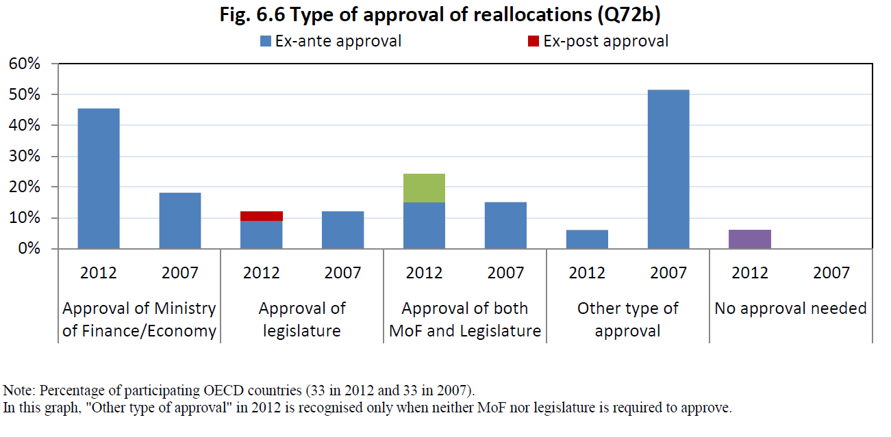
Optimising investment and resource allocation
Government officials’ misunderstanding of rules may lead to unnecessary risk aversion, while altering regulations can change incentives and ability to innovate.
Budget rigidities can limit flexibility and horizontal collaboration.

Slide 10
Rethinking regulations and procedure
“The largest percentage of obstacles were internal to the bureaucracy, encompassing more than 50% of all obstacles…” Sandford Borins, 2014
Phantom rules and procedures
Unwritten rules and conventions
Unexercised discretion
Inertia
Red tape reduction
Rule exemptions
Innovation delivery teams
Behavioural science
Culture change

Slide 11
Example: (Re)designing a hospital
Managing risk and uncertainty

Slide 12
Innovation: From Art to Science

